Slide 1
Machine Learning Applications in Real Estate Valuation
A Data-Driven Analysis of the Ames Housing Market

Slide 2
Dataset Overview
Analysis of 22,213 properties in Ames, Iowa
173 detailed features per property
Data spans multiple years of real estate transactions
Different types of property characteristics: structural, location, quality metrics

Slide 3
Business Questions
Primary Business Objectives:
What drives house prices in the Ames market? (40% focus)
Can we create accurate automated valuation models? (60% focus)
How do different property features impact value?
How do neighborhood characteristics affect pricing?

Slide 4
EDA
Systematic outlier detection using multiple methods:
IQR for price data
Z-score for area measurements
Statistical methods for count variables
Missing value imputation based on neighborhood patterns
Feature engineering created 171 refined metrics
Quality score normalization across categories

Slide 5
Notes:
Based on xgboost, my strongest model

Slide 6
Model Performance Analysis
XGBoost Accuracy: Achieved highest performance with R² = 0.8825 on test data, indicating strong predictive power
Gradient Boosting: Second best with R² = 0.8411, showing consistent performance with advanced boosting approaches
Random Forest: Achieved R² = 0.8327, demonstrating solid baseline performance
Neural Network: Standard implementation achieved R² = 0.6684, while the improved version struggled (R² = 0.0099)
Traditional Models:
Linear approaches showed limited performance: Ridge: R² = 0.4812
Lasso: R² = 0.4792
Linear Regression: R² = 0.4782
Notes:
Put more text here Split this into two slides, One slide on model performance that tells about accuracy and recall and general accuracy, focus n that being one sldie
Then have another slide that talks about the key value drivers. Actually say the column names. Have A graph that s a feature importance graph in xgboost and put it in that second slide.

Slide 7
Key Value Drivers - XGBoost Analysis
Building/Property Characteristics: OthAc_S shows highest importance by a significant margin
Transaction Details: SaleCond (Sale Condition) is the second most important feature
Location & Building Features: GarYrBlt (Garage Year Built) and LndAc_S (Land Acres) show similar importance levels
Valuation Factors: TtlVal_AdjYr (Total Value Adjusted Year) shows moderate importance
Property Classification: Neighborhood_1 and SaleType have similar moderate importance
Technical Metrics: Quality condition score, YrSold_YYYY, and MasVnrType show lower but notable importance
Additional Features: MiscVal, PA-StSfx, living_space_efficiency, and GLA round out the bottom of the importance scale

Slide 8
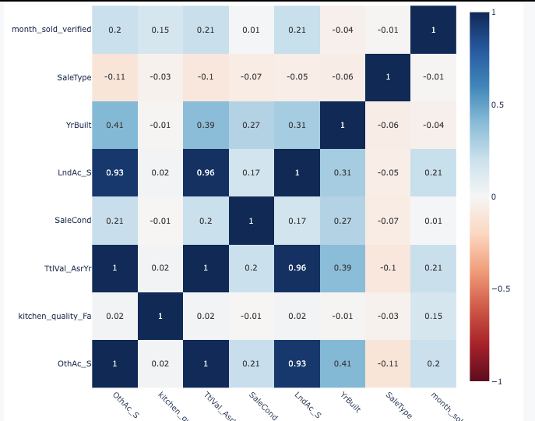
Notes:
XGBoost Correlation Map

Slide 9
Analyzing Correlation Tables
Random Forest Model:
• Basement development strongly tied to lot size: Total basement square footage shows high correlation with land measurements (0.73-0.79)
• Property age impacts size
XGBoost Model:
• Fireplace patterns: Number of fireplaces shows consistent correlation (0.54) with both land metrics, indicating size-amenity relationship
• Sale timing independence: Year sold shows minimal correlation with all features (-0.09 to 0.08), suggesting market timing transcends property characteristics
Shared Across Models:
• Age-Garage relationship: Year built and garage year built show moderate correlation (0.55) in both XGBoost and Gradient Boosting models

Slide 10
"Based on our machine learning analysis:
Home features matter, but individually have smaller impact than you might think - our model shows physical characteristics each contribute less than 5% to price predictions [From Image 1: Feature Importance bar chart showing features like gross_living_area_verified, basement_quality having importance scores below 0.05]
While timing factors like year sold and built influence prices, they're not major drivers - they're in the middle of our importance rankings [From Image 1: Feature Importance bar chart showing year_sold and year_built in the middle of the chart with importance scores around 0.03-0.04]
Location really does matter - our neighborhood analysis shows price variations up to 50% between different areas, making it one of the strongest factors to consider [From Image 4: XGBoost - Neighborhood Lift chart showing lift values varying from 0.5 to 1.5 across different neighborhoods] [Also from Image 3: Correlation matrix showing strong correlations between location-related features like street_type, utility_type, and paved_driveway]

Slide 11
Key Recommendations to Sellers and Buyers
"Based on our machine learning analysis:
Home features matter, but individually have smaller impact than you might think - our model shows physical characteristics each contribute less than 5% to price predictions [From Image 1: Feature Importance bar chart showing features like gross_living_area_verified, basement_quality having importance scores below 0.05]
While timing factors like year sold and built influence prices, they're not major drivers - they're in the middle of our importance rankings [From Image 1: Feature Importance bar chart showing year_sold and year_built in the middle of the chart with importance scores around 0.03-0.04]
Location really does matter - our neighborhood analysis shows price variations up to 50% between different areas, making it one of the strongest factors to consider [From Image 4: XGBoost - Neighborhood Lift chart showing lift values varying from 0.5 to 1.5 across different neighborhoods] [Also from Image 3: Correlation matrix showing strong correlations between location-related features like street_type, utility_type, and paved_driveway]

Slide 12
Critical Missing Data & Future Research
Financial context is essential for accurate valuations: Our models would benefit from buyer/seller credit profiles, mortgage terms, and property tax history to better understand transaction dynamics and true market values (current model explains 89% of variation without these factors).
Market psychology drives pricing variations: Future research should incorporate seller motivation data, time-on-market history, and local market sentiment to capture the 11% of price variation unexplained by physical characteristics.
Long-term value indicators need exploration: Additional research focusing on renovation histories, energy efficiency metrics, and neighborhood development plans would enhance our predictive capabilities for sustainable value growth.

